Slide 1
Lesson 7- Copy the Question and Write your Answer
Please write one sentence per bullet point
How does the Legislative Branch make laws?
How does the Executive Branch enforce laws?
How does the Judicial Branch review laws?
Name one example of how one branch interacts with another branch.

Slide 2
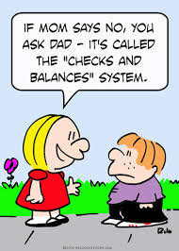
Checks and Balances
Our system of Separation of Powers

Slide 3
Who’s got the Power?
With your shoulder partner
You will indicate which Branch of the Government has which Power on the Chart
For Example: if the Power said Overrides a Presidential Veto the answer is Legislative Branch
You will have 5 minutes

Slide 4
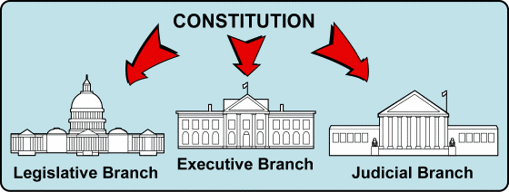
Separation of Powers
When the Founding Fathers wrote and ratified the Constitution they wanted to make sure that the government did not abuse its power
The Founders separated Federal Power into 3 branches of government;
The Legislative (law-making)
The Executive (law-enforcing)
The Judicial (law-interpreting)

Slide 5
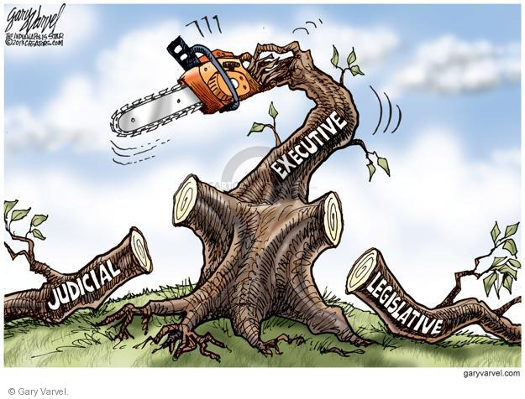

Slide 6
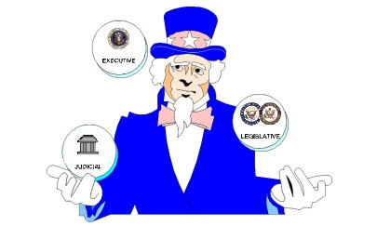
Which Branch has which powers?
Legislative Branch:
Power to introduce bills
Collect taxes
Regulate commerce with foreign countries
Coin Money
Declare War
Executive Branch
Commander-in-Chief of the U.S. Army and Navy
Make treaties
Propose and veto legislation
Nominate Justices to the Court
Appoint the Cabinet
Judicial Branch
Supreme Court and Lower Courts
Interpret U.S. law and issue judgements

Slide 7
Checks & Balances
In addition to separating powers among the three branches of government
The Founders created a system of checks and balances
This enables each branch to limit the powers of the other two branches
Preventing abuse of power

Slide 8
An Example of Checks & Balances
Check
The process by which a bill becomes a law
The Legislative branch is the only branch that has the power to introduce legislation
All bills passed by both the Senate and the House of Representatives must be presented to the president.
President can sign a bill into law, veto a bill, or do nothing
If bill is vetoed Congress can overturn the veto by a two-thirds vote
The Judicial branch checks the law-making powers of the executive and legislative branches by declaring the law unconstitutional
Check
Check
Check

Slide 9
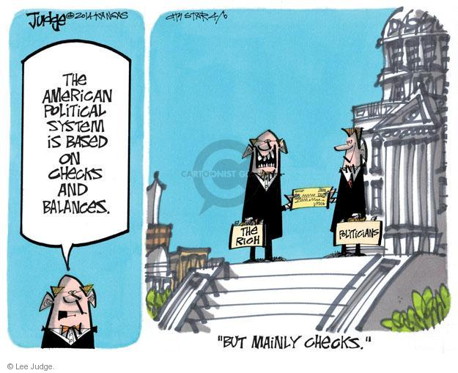

Slide 10
How can the Legislative Branch Check the other two branches
The Legislative Branch checks the Executive Branch when
legislators override presidential vetoes
impeach and convict a president.
The Legislative Branch checks the Judicial Branch when
legislators confirm or refuse to confirm judges/justices
impeach and convict judges/justices.

Slide 11
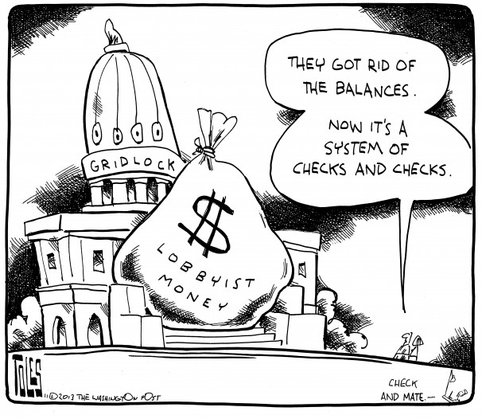

Slide 12
How can the Executive Branch check the other two branches?
The Executive Branch checks the Legislative Branch when
the president proposes legislation,
prepares an annual budget for Congress to approve,
call special sessions of Congress,
vetoes legislation Congress has passed.
The Executive Branch checks the Judicial Branch when
the president appoints (nominates ) judges/justices.

Slide 13
How can the Judicial Branch check the other two branches?
The Judicial Branch checks the Legislative Branch when
By judges/justices declare acts of Congress to be unconstitutional.
The Judicial Branch checks the Executive Branch
By declaring executive actions to be unconstitutional.

