Slide 1
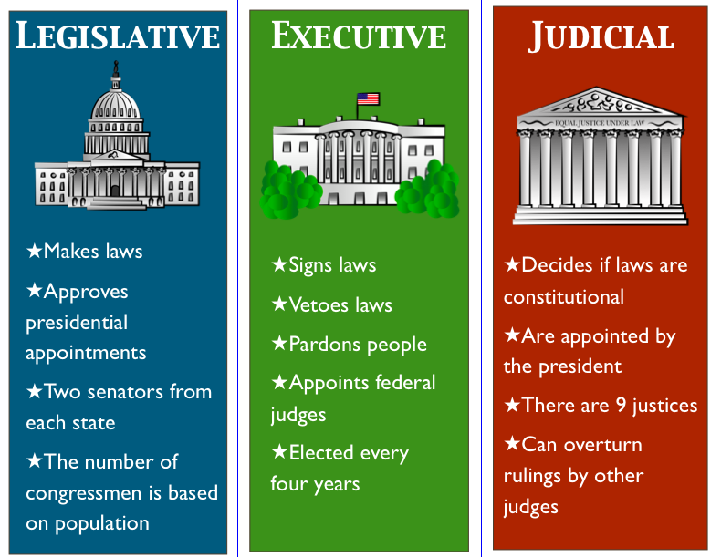
Bellwork: Lesson 6- Copy This

Slide 2
Legislative Committees

Slide 3
What are Congressional Committees?
Both the House of Representatives and the Senate have Committees
Committees are in place in order to make Congress more effective
Committees help divide up the work
It is more efficient to write legislature in a small group rather than a large legislative body
It allows congress members to develop certain expertise on a topic
So a congressman from Polk County, Florida would do well on an Agriculture Committee because if he pays attention at all to his constituents he would be an expert on this topic.

Slide 4
Who runs a committee?
Committee Chairman
The Committee Chairman chooses what Bill will be heard by the Committee
The Chairs also manage the actual process of writing a Bill, which is called Mark-Up, and the vote on the Bill of the Committee itself

Slide 6
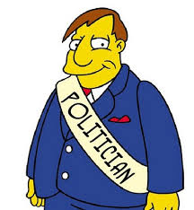
How does a committee benefit the Politician
Once you are assigned a committee it is very unusual to move around and change committees
Allows Politician to follow what he or she is passionate about
IF a congressman is interested in national defense he or she can get onto the Armed Services Committee
This allows an individual to develop expertise on a subject
Probably more important is that joining a committee is something a congressman can claim credit to and use to help build a profile for reelection.

Slide 7
How do committees work?
Any congressman has the power to propose a Bill
This is called Proposal Power
However this has to go to a Committee first before going to the rest of the House or Senate
The Committee Chairman makes the Agenda of Bills that the committee will hold
This is a remarkably important power called Gate Keeping Authority
The Chairman has the discretion to choose what is worthy of being heard and what is not
If a Bill doesn’t receive enough votes in the Committee the House or Senate floor will never hear it
In this case we say that the Bill died in Committee

Slide 8
Types of Committees
There are four primary types of committees
Standing Committees
Select or Special Committees
Joint Committees
Conference Committees

Slide 9
Standing Committees
Permanent Committees
Standing Committees are by far the most important structures in Congress
These committees deal with day-to-day issues
The House has 19 committees and the Senate has 16
Every Congressman serve on multiple committees
Typically, 2 committees

Slide 10
Standing Committees in the House and Senate

Slide 11
Special Committees
Deal with particular issues that are beyond the Jurisdiction of standing committees
Some are temporary others are permanent
Usually disbanded at the end of the Congressional session
Narrow focus on a very specific topic
These Committees produce reports not legislation.

Slide 12
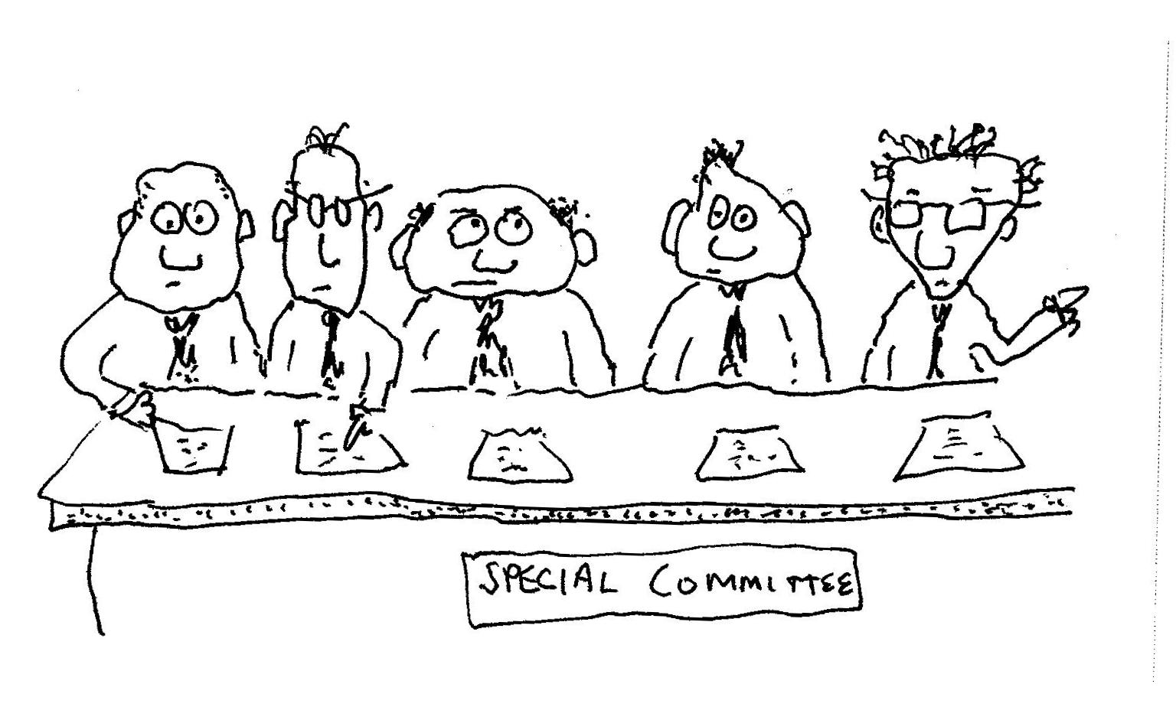

Slide 13
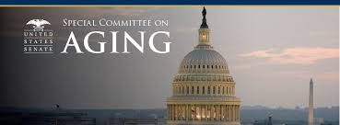
Examples of Special Committees
The 105th Congress convened a special committee to examine the issue of aging
Congress also has employed select committees to investigate the Iran-Contra and the Watergate Scandal

Slide 14
Joint Committees
These committees are composed of members from both the House of Representatives and Senate
They deal with administrative matters pertaining to Congress
Either permanent or temporary
They tend to produce recommendations not legislation

Slide 15
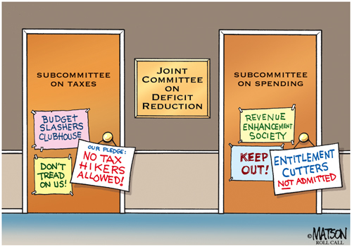

Slide 16
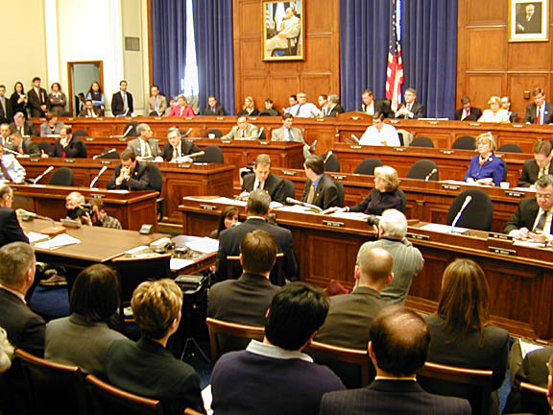
Conference Committees
These committees are also composed of House and Senate members
They have the expressed purpose of standardizing the exact language of concurrent pieces of legislation that the two chambers have passed

Slide 17
Activity
On your paper explain what the importance is of Congressional Committees
Discuss with your partner the importance of Congressional Committees

