Slide 1
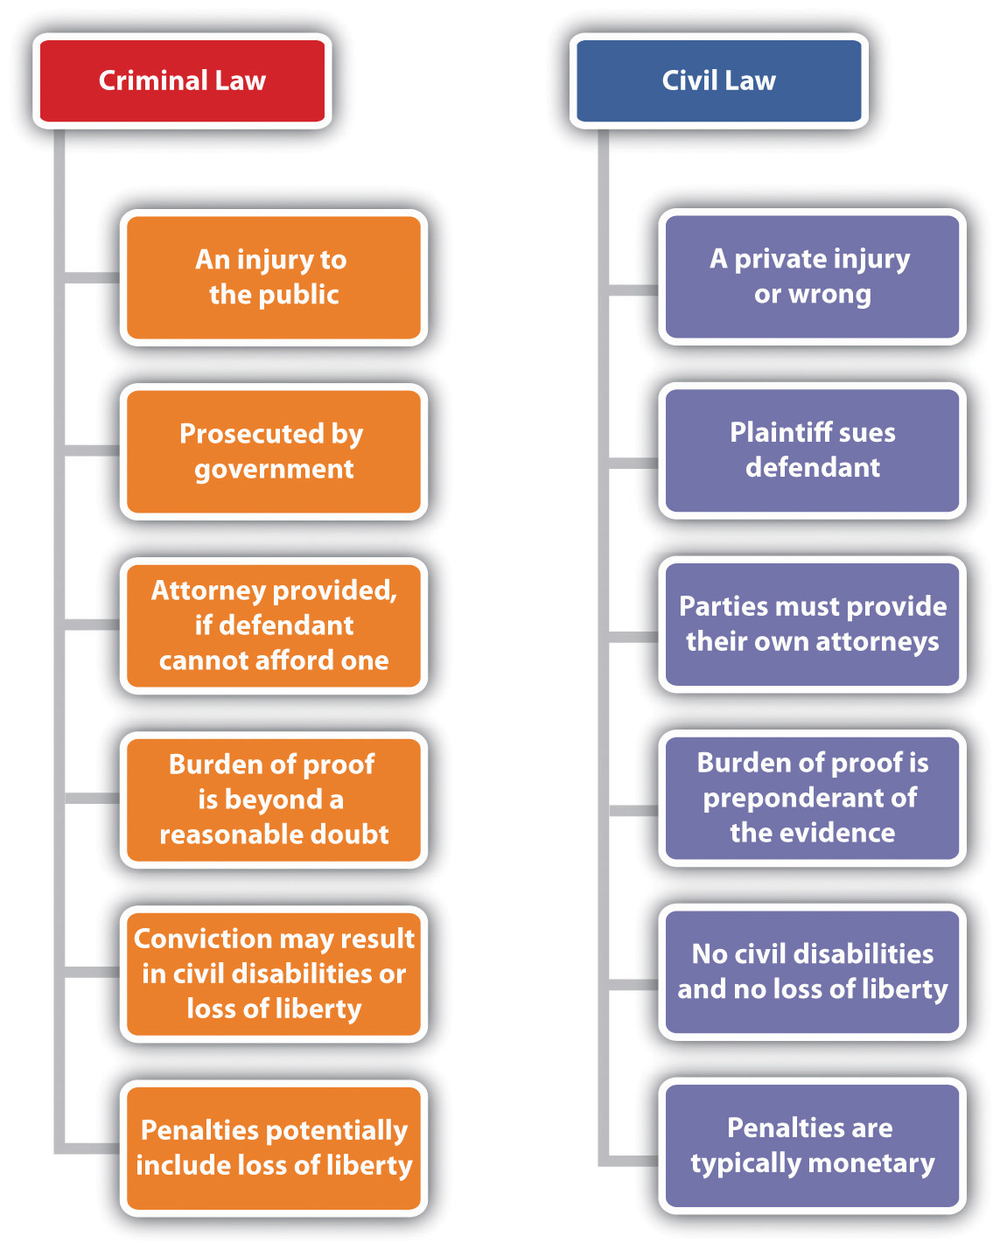
Lesson 5

Slide 2
Organization of the Federal & State courts

Slide 3
Why do we have both State and Federal Courts?
The U.S. Constitution is the supreme law of the land in the United States.
It creates a federal system of government in which power is shared between the federal government and the state governments.
This is known as Federalism
Due to federalism, both the federal government and each of the state governments have their own court systems.

Slide 4
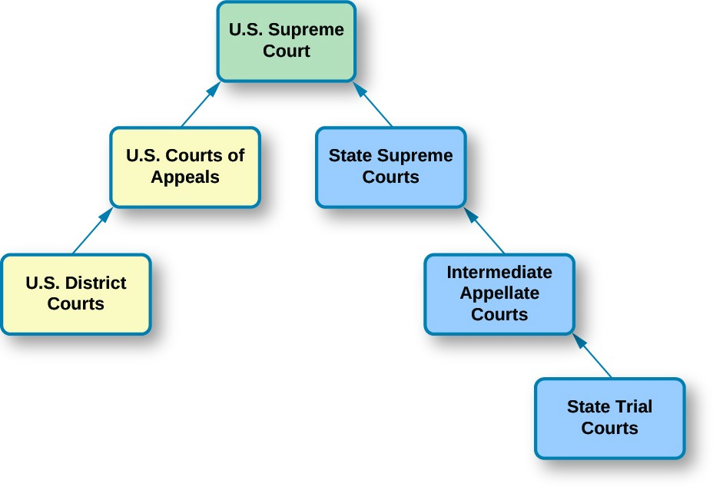

Slide 5
What do courts do?
A court is a forum that is able to handle and resolve disputes
A case's facts are proven
Verdicts are given
Punishments and compensations are distributed
Courts interpret laws and apply them to real-life situations
Judgments are made based on the facts established within the courtroom
Courts deal with both criminal and civil cases

Slide 6
What kind of cases do State Courts hear?
Most criminal cases
Personal injury cases
Divorce, adoptions, marriage, juvenile
Family court
Issues with Wills and Estates

Slide 7
State Court System
Each State has its own court system
Inside each state there are different levels of courts
Trial Courts
Most cases start in these courts
Trial courts deal with serious crimes or disputes over larger amounts of money or property
Appeals Courts
People can appeal decisions made in Trial Courts
Request review
States Supreme Courts
Highest Court in the State
Can review all decisions made in lower courts
Special Courts- Divorce Court, Juvenile Court, Probate Court (deals with wills), etc.

Slide 8
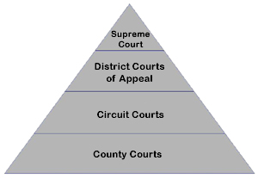
Florida Court System
Florida has two types of Trial Courts
Circuit: 20 Judicial Courts
County: One country court for all 67 counties
Florida has two types of Appellate Courts
Florida Supreme Court
Highest Appellate Court
District Courts of Appeals
There are five District Courts of Appeals
Tallahassee
Lakeland
West Palm Beach
Daytona Beach
Miami

Slide 9
What kind of Cases go to Federal Courts?
Cases dealing with:
Determining if a law is constitutional or not
Disputes between two or more states
Or a citizen in one state versus a citizen in a different state
Dispute of a U.S. law or treaty
Cases involving ambassadors or public ministers
Habeas Corpus
Bankruptcy
Patent or copyright

Slide 10
Court of Appeals
Similar to States
If either the Prosecutor or the Defendant believe a mistake was made they can take it to the Federal Court of Appeals
There are 13 circuits
These trials do not “re-try” the case
There is no jury, witnesses, evidence
Rather, these courts evaluate the procedures and the decisions in the trial court
They ensure that the case was tried properly and fairly

Slide 11
U.S. Supreme court
The U.S. Supreme Court can be used if you think the Court of Appeals or the State Supreme Court if either side believes a mistake was made.
However, remember the U.S. Supreme court chooses to see or not see cases
The Supreme Court was created by the U.S. Constitution.
It is the head of our entire judicial branch of government
Both the state and federal systems

Slide 12
Original Jurisdiction
Jurisdiction refers to the kinds of cases a court is authorized to hear.
Original Jurisdiction refers to the court that heard the case first (so it will never be an Appeals Court)
Original Jurisdiction courts are Trial Courts
States and Federal courts have different jurisdiction
Federal: limited jurisdiction
federal crime, violation of constitutional rights, bankruptcy, federal tax violation, copyright
Cases that cross state lines: Like a civil suit involving two citizens from different states
State: General jurisdiction
States deal with most cases
State crime, divorce, traffic, custody, probate, malpractice

Slide 13
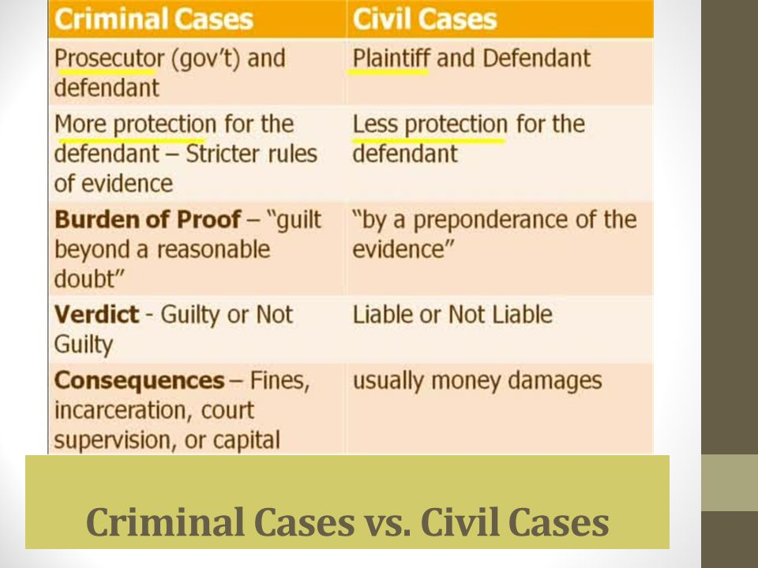
Criminal Vs. Civil Cases
https://www.youtube.com/watch?v=Zg5ex8WZUao

Slide 14
