Slide 1
Bellwork: Lesson 9
Bill: a proposed law
Law: the set of rules and standards by which a society governs itself
Rider: a provision on a subject other than the one covered in the bill this is in order to secure its passage or defeat
Hearing: a session at which a committee listens to testimony from people interested in the bill
Amend: to change
Veto: rejection of a bill by a president
Pocket Veto: when a president kills a bill passed during the last ten days Congress is in session by simply refusing to act on it.

Slide 2
How a Bill Becomes A Law

Slide 3
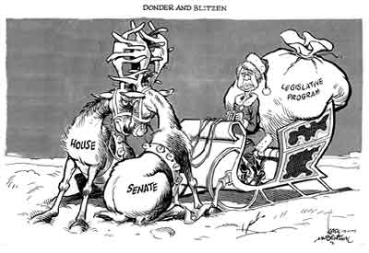
President Jimmy Carter as “Santa Clause”
House and Senate are “locking horns”
Presents

Slide 4
School House Rock: How A Bill Becomes a Law
https://www.youtube.com/watch?v=FFroMQlKiag

Slide 5
Big Picture
The number one job of the legislative branch is to make laws
Out of the thousands of bills introduced in each session of Congress only a few hundred become law
Most die in Congress
Some are vetoed by the President
If a bill is not passed before the end of that congressional session (two years), it must be introduced again in the next session to be given further consideration.
The process for a bill to become law is difficult and can take a long time
Fewer than 10% of bills become law

Slide 7
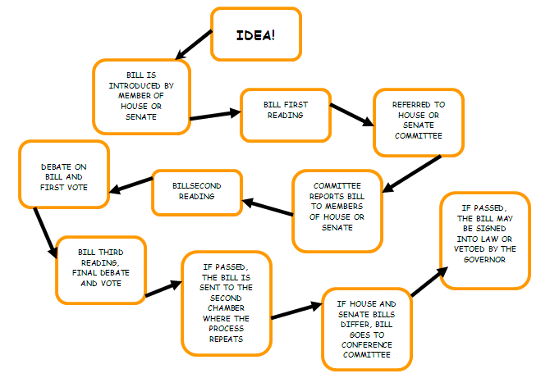
Referred by the House Speaker or Pro Tem
Bill is either Reported or Dies in Committee
President
Conference Committees Standardize Language
If the Bill is amended goes back to first chamber

Slide 8
First Step
To make a bill you need an idea!
An idea for a bill may come from anybody
However, only members of congress can introduce it
Recent “talked about” Examples of Ideas for a Bill:
Raising Minimum Wage
Free public universities
Recycling Incentives or making it mandatory
Tax incentives for making your house energy-efficient
Subsidized Parental Leave (Paternal and/or Maternal)

Slide 9
Second Step
Bill is introduced by a member of Congress
Any member can introduce a bill it is called Proposal Power
Ideas for Bills come from citizens, lobbyists, or other representatives of interest groups, and the executive branch
Bills may be drafted by legislators, their staff, congressional lawyers, or a representative from an interest group
A bill can have a sponsor (the introducer) and cosponsors (other congressmen)
This shows the bill has wide support

Slide 10
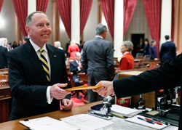
How to introduce a bill
In the House, a member drops the bill into the hopper, a box near the clerk’s desk
In the Senate, the presiding officer must first recognize the senator, who then formally presents the bill.
Once a bill is introduced:
It is given a title and number
For example in senate its S.1 and the House it is H.R. 1
Printed and distributed to lawmakers
These steps are considered the first “reading” of the bill

Slide 12
Third Step
Committee Action
Bills are Sent to Committees that deal with the subject
What can a committee do?
Reject the bill- let it die, or pigeonhold it, which means they ignore it
Kill the bill- reject it by a majority vote
Act on the bill
Rewrite the bill
Amend it- Mark Up
Or recommend it be adopted as is
Committee sends it to the House or Senate once approved.
When acted on: Committees hold hearings where they listen to testimony on the bill’s subject. This allows them to gather information about the bill.

Slide 13
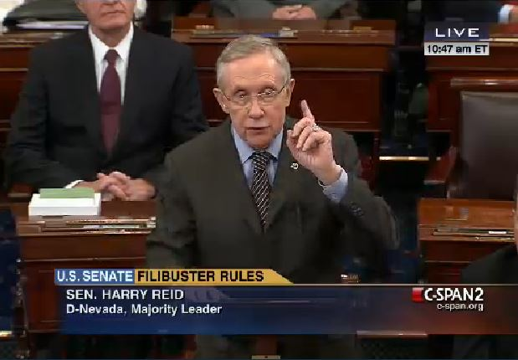
Fourth Step
Once reported to the House or Senate by Committee it goes to Floor Action
A clerk reads the bill section by section- “Second Reading”
Once a section is read Congressmen debate and can propose amendments to each section

Slide 14
Fifth Step
After floor debate the bill is ready for a vote
This includes the bill and any proposed changes
A quorum (majority) must be present
Bill is read for third time
Vote is taken
3 ways to vote
Voice Vote: Members call out “Aye” or “No”
Standing Vote: “Ayes” and “Nos” stand to be counted
Roll-call Vote: Each member says “Aye” or “No” as names are called in Alphabetical Order
The House also can use a fourth method where its recorded electronically and displayed on panels

Slide 15
Sixth Step
Once passed by one house:
Bill is sent to the other house to repeat steps 3-5 or they can skip right to a vote

Slide 16
Seventh Step
Presidential Action
Article 1, Section 7 states that “Every Bill which shall have passed the House of Representatives and the Senate, shall before it becomes a Law, be presented to the President.”
After the bill has been approved identically by House & Senate the President receives it.
The President can either pass it (sign it)into law
Or Veto it where it will return to the house where it originated

Slide 17
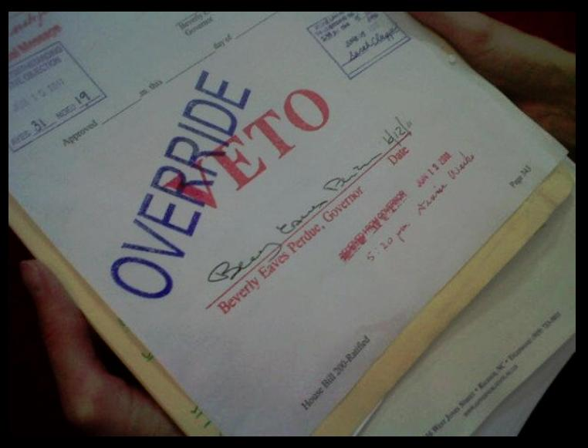
Congressional Override of a Bill
Congress can override a President’s veto with a 2/3 vote
Once overridden it becomes law
This seldom ever happens
Congressional Override is an example of
______ &_____

Slide 18
Flow Chart
Complete the flow chart on back of notes
Use the seven steps to help you fill in the box
Give each box a title (For example: Step 7- Presidential Action)
Give a short description of what is done at that step

Slide 19
Flow Chart Example

Slide 20
Did you ever think: “that ought to be a law…”
You will be creating your own Bill
Explain it: 3-5 sentences explaining your Bill
Justify it: 5 sentences justifying why there is a need for that Bill. Why is this Bill important?
Give it a Committee: 1-2 sentences explain what committee do you believe your bill should be recommended to and why
Analyze it: 3 Sentences explain if you think your bill will pass each step to becoming a Law or not. Why do you think this will easily pass/ fail?
Draw it: Draw a picture that represents the Bill
YOU MUST USE COMPLETE SENTENCES AND PROPER GRAMMAR/SPELLING TO RECEIVE AN A!

