Slide 1
BELLWORK-Lesson 10
In 1 paragraph: Explain why the process of a bill becoming a law is so difficult. Describe what you think would happen in our country if making laws were an easier process.

Slide 2
Understanding the Job of a Congressman
Who are your Representatives?

Slide 3
Lesson Learning Outcomes
You will recognize what a congressional district is and identify how many congressional districts Florida has.
You will identify the complexity of a congressman’s day-to-day activities.
Students will be tasked with researching and analyzing the political background, voting history, and floor activities of the Representatives serving our local districts.

Slide 4
Refresher: What are the Responsibilities of Congress
The number one job of congress is to MAKE LAWS
Congress also has the power to:
Declare War
Coin Money
Levy Taxes
Raise an army/navy
Regulate Commerce
Establish rules of immigration
Establish Federal Courts
Implied
What are the Powers that are only meant for the Federal Government called?
Hint: Think Federalism
Expressed
Enumerated

Slide 5
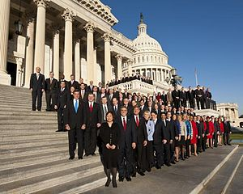
What are the daily Responsibilities of a Congressman
Those who live in the district they represent
The Job of a Congressmen is to represent his/her constituents
Primarily a congressman’s responsibilities include: representation, legislation, constituent service, and political activities.
Let’s take a more in depth look into a congressman’s responsibilities…

Slide 6
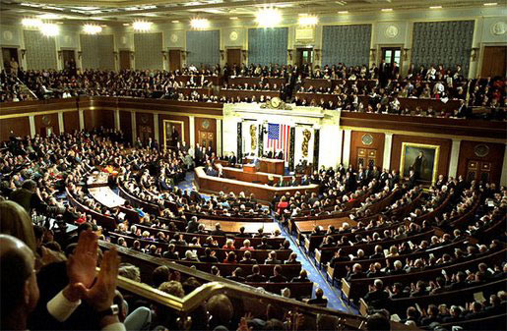
Attending Sessions of Congress and Voting
The primary duty of a congressman is to attend congress and vote
Participation in committees
Negotiation of legislation
Regular attendance in congress
Participating in debate

Slide 7
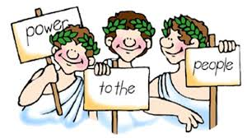
Representation
Represent those that live in their district/state
Represent America
Although the Congressman’s number one job is to represent his district he must consider Americans as a whole
For example, a House member from a state with a large agriculture industry might vote to repeal agricultural subsidies despite the negative impact on his local constituents, as reducing the deficit will improve economic conditions for all Americans.

Slide 8
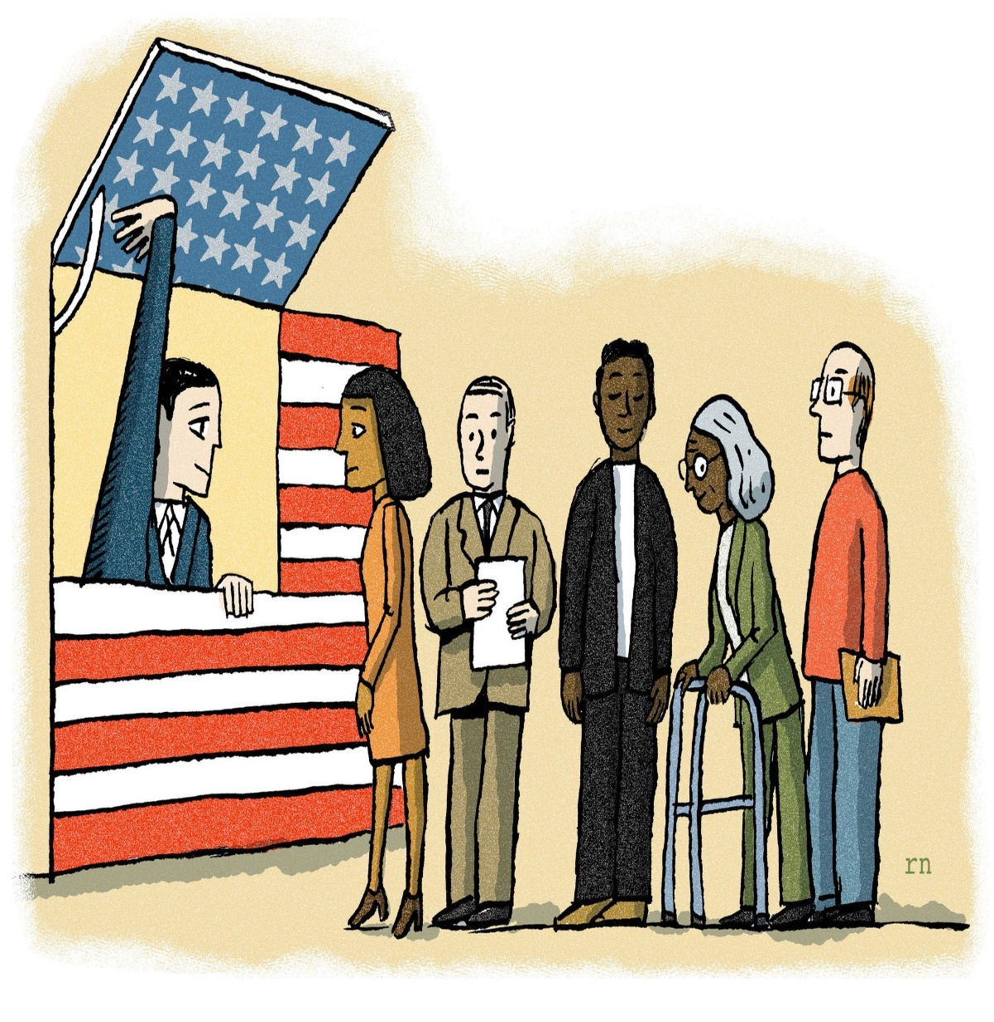
Constituency Service
Congressmen provide service for their constituents
Constituency service duties include
Outreach to explain current laws and federal programs to constituents
This includes Town Halls and other informational meetings
Being the spokesperson for his constituents to Congress and a Spokesperson of Congress to his constituents
Forwarding nominations to United States military service academies
Arranging tours of the Capitol, White House or other important locations.

Slide 9
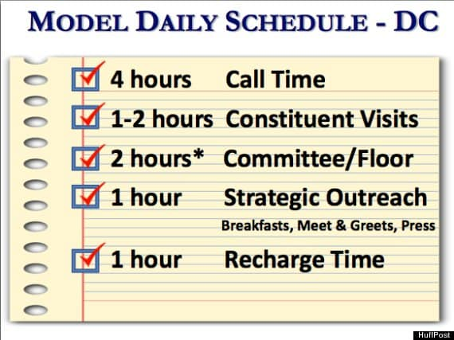
A look at a Congressman’s Schedule

Slide 10
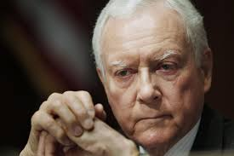
A Day in the Life of Pro Tem: Orrin Hatch
https://www.youtube.com/watch?v=Vq9ANWQeUYA

Slide 11
Number of House Representatives per State

Slide 12
Congressional Districts
A Congressional District is a territory of the State that a United States House of Representative represents

Slide 14
Who represents me?
Everyone is represented by their States 2 Senators
Bill Nelson- Democrat
Marco Rubio- Republican
Everyone belongs to a Congressional District
Depending on you zip code you could be represented by any of the 3 following U.S. Representative
Darren Soto
Dennis Ross
Thomas Rooney

Slide 15
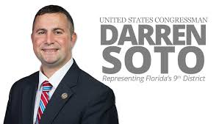
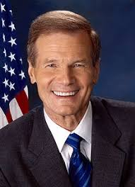
My Representatives

Slide 16
Research Assignment
The Class will be split into 5 groups
As a group you will be reading about one of the 5 congressmen
Your job is to understand who that congressman is this includes his biography, party affiliation, what committee he is on, floor action, how long have they been in office, etc.
As a group you will read your information in a round robin style. Meaning one person will begin, read a paragraph, next person, reads a paragraph. So on and So on.
Once you have completely read your paragraph you and your team will fill in the chart
After we will break into groups and report our Congressman to other classmates

Slide 17
Round Robin Presenation
Order of Presentation: Bill Nelson, Marco Rubio, Darren Soto, Dennis Ross, Thomas Rooney
Explain your chart to the group
After everyone has gone describe the similarities and differences between each representative/senator
Does anybody specifically stick out? Is everyone very similar?
Did anything surprise you?
Were issues important to you discussed by one of the congressmen?

