Slide 1
Bellwork- Please Copy

Slide 2
Judicial Branch
An Overview

Slide 3
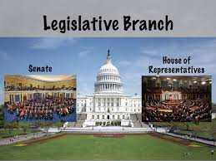
Recap: The Legislative Branch
Headed by Congress
Bicameral System- includes the House of Representatives and the Senate.
The main task of these two bodies is to make the laws.
Its powers include:
passing laws
originating spending bills (House)
impeaching officials (Senate)
approving treaties (Senate)

Slide 4
Recap: The Executive Branch
The executive branch carries out and enforces laws.
It includes:
The President
Vice President
The Cabinet
Executive departments
Independent agencies
Other boards, commissions, and committees

Slide 5
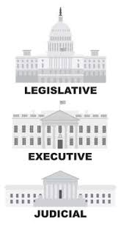
What is Law?
Law is the set of rules and standards by which a society governs itself
Law
Resolves conflict
Protects individuals against government power
Defines criminal acts and punishments

Slide 6
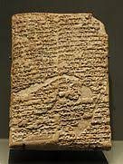
Early Systems of Law
Babylon-
Hammurabi’s Code
Rome-
Twelve Tables
Medieval England-
Feudal System

Slide 7
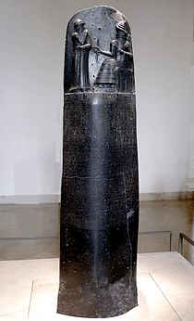
What is the Hammurabi Code?
Babylonian Code of Law
282 laws
Written for all to see- Public knowledge
Dealt with everything from marriage, trade, taxes, and murder.
Specific punishments to fit specific laws
Eye for an Eye, a Tooth for a Tooth
Tough on crime?

Slide 8
If any one is committing a robbery and is caught, then he shall be put to death

Slide 9
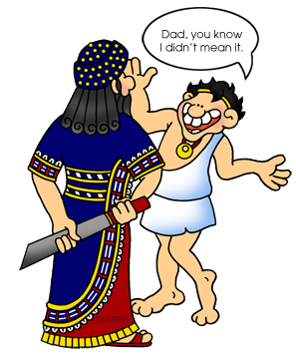
If a son strikes his father, his hands shall be hewn off.

Slide 10
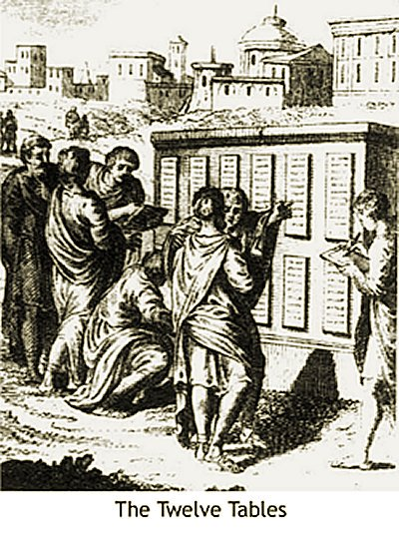
Twelve Tables
Written 450B.C.
Considered one of the most detailed legal code of the ancient civilizations
Romans wrote down legal opinions to help form the law
People were considered to be innocent until proven guilty
There was a uniformed legal code used for all of the Roman Empire
Most of our laws are based on those of ancient Rome.

Slide 11
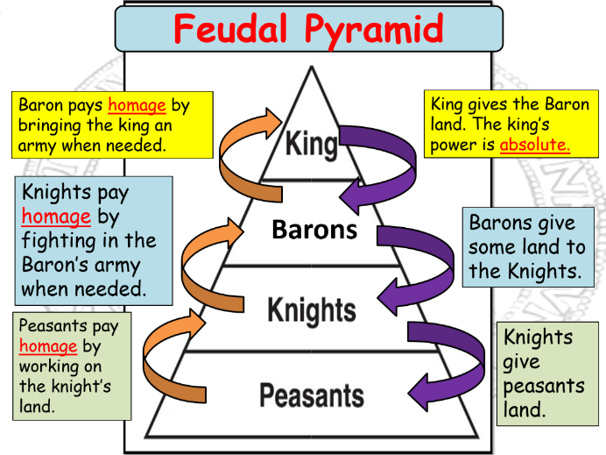
The Feudal System
It was a system of legal and military customs found in medieval Europe
This society was a military hierarchy.
In basic terms the King would exchange land for loyalty (military service)

Slide 12
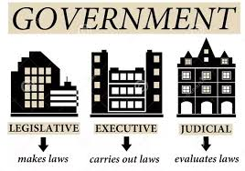
In short…
Every society needs to have laws to protect itself and its members
Even ancient civilizations had laws

Slide 15
Principles of Democracy in the Judiciary
Our democratic principles ensures that every person should have a free and equal opportunity to pursue individual goals and desires.
So that no one’s rights are being infringed we have agreed upon certain guidelines for our behaviors.
Citizens elect representatives to make laws
Laws can be written unclear
When this happens the judicial branch provides an interpretation of the law
The Judicial branch resolves conflicts

Slide 16
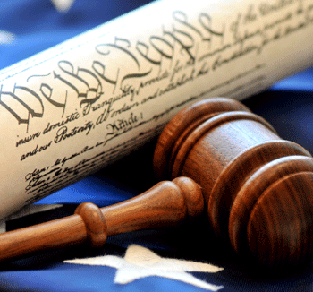
Rule of Law
The Rule of Law means that no one is above the law
No individual, group, organization, or governmental entity
Everyone must obey the law and be held accountable if the violate it
Therefore, laws must be clear and known to all
Laws are meant to be equally, fairly, and consistently enforced

Slide 17
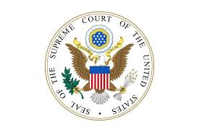
Controls on the Abuse of Power
The Judicial Branch plays a key role in our system of checks and balances
The Judiciary may limit the other branches to declare laws and government actions unconstitutional.

Slide 18
Article III of the Constitution
Establishes and empowers the judicial branch of the national government
“The judicial power of the United States, shall be vested in one Supreme Court, and in such inferior courts as the Congress may from time to time ordain and establish.”
Must have a Supreme Court
Congress is given power to create and remove lower courts.
Section 1 of Article III creates the federal courts
Section 2 of Article III talks about the powers of the judicial branch and explains who gets each power
Section 3 of Article III defines treason and how to prove someone has committed treason

Slide 19
The Function of the Supreme Court
The Supreme Court is the highest court in the land
This court sits at the top of the judicial branch in our democracy.
Primary Function: resolve disputes that arise over the meaning of federal law and the U.S. Constitution.
Important Power: Judicial Review
Judicial Review- power the Court has to examine the laws and actions of local, state, and national governments and to overturn them if they violate the constitution.
The Supreme Court can decide what a federal law means or whether any law is unconstitutional.

Slide 20
Supreme Court Rulings
The decisions of the Supreme Court are absolute and final
Different from lower courts
The decisions and judgments reached in lower courts may be appealed or questioned
Thousands of requests for rulings reach the Supreme Court each year
Fewer than one hundred fifty are actually considered and ruled upon

Slide 21
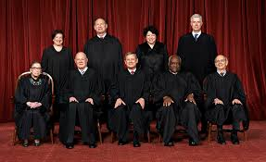
Supreme Court Justices
There are 9 Justices
1 is the head Justice (Chief Justice) and 8 are the associate Justices
The longest serving Chief Justice was Chief Justice John Marshall who served for 34 years, 5 months and 11 days from 1801 to 1835.
The longest serving Associate Justice was William O. Douglas who served for 36 years, 7 months, and 8 days from 1939 to 1975.
The average number of years that Justices have served is 16.
As of April 2017, there have been 113 Justices in total.
6 justices were born outside of the country
1 justice has been both a president and a justice (President Taft)

Slide 22
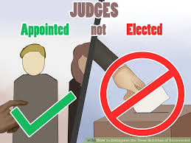
Nomination and Confirmation Process
Justices are not elected nor are they accountable anyone
Only accountable to the law
Justices keep their jobs for life
The constitution does not have an age, citizenship, or education requirement for justices.
Only 2 requirements
Must be nominated by the President
Confirmed by the Senate
The Senate has confirmed about 80 percent of presidential Supreme Court nominations.

Slide 23
Merit and Ideology
Presidents want someone with extraordinary personal integrity and professional expertise.
All are trained as lawyers and demonstrate thorough understanding of the law.
Common traits of Justices
Excellent education and training
Outstanding oral and written communication skills
Past judge or lawyer
Committed to equal justice under the law

Slide 24
President’s Choice
To allow a president’s legacy to live on past his term a president tends to choose justices that are in line with the president’s ideology
Meaning if the President leans right he will choose a more conservative justice
Or if the president leans left he will choose a more liberal justice
It is important to note that a President cannot predict exactly how a justice will vote on a controversial issue.

