Slide 1
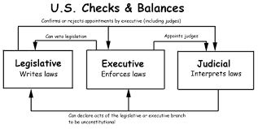
Bellwork: Lesson 6
Please write down the question and answer in 4 sentences.
Please explain in your own words what is the system of Checks and Balances. Give 3 complete examples of a check.

Slide 2
Legislative Branch
A Tour of Article 1 of the U.S. Constitution

Slide 3
Legislative Branch
Described in Article 1 of the Constitution
Main role of branch is to Make Laws
Responsible for writing and passing all federal laws
The Branch is led by congress
Congress is Bicameral: House of Reps and Senate

Slide 4
A Congressman’s Responsibilities
Representing the interests of his/her constituents
Working together to write laws
Overseeing other government agencies
Passing Bills

Slide 5
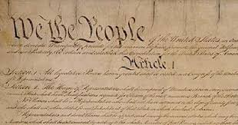
Article 1
Article 1 of the Constitution outlines the Legislative Branch there are ten sections
It determines the functions, powers, & parameters of congress
The Constitution gives BOTH the House and the Senate the power to tax, coin money, declare war, regulate foreign and interstate commerce
A Bill can originate in either the House or the Senate

Slide 6
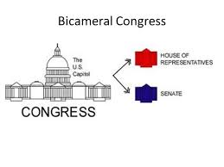
Bicameral House
Article 1 Section 1 outlines that Congress will be a Bicameral House (two-houses)
The Great Compromise: New Jersey Plan & Virginia Plan
This is out of a historical need and practical need

Slide 9
Article 1 Section 5: Rules and Procedures
Quorum: Both houses need half of their representatives present to meet quorum and be able to conduct official business
Super Majority: 2/3 needed to be able to expel a member or impeach
A Filibuster is a political procedure where one or more members of parliament or congress debate over a proposed piece of legislation so as to delay or entirely prevent a decision being made on the proposal. Only Cloture (takes a 3/5s vote) can force debate to end after 30 more hours
“talking a bill to death”

Slide 11
Article 1 Section 6: Privileges and Restrictions
Salary is set by law. Currently members make $162,000 the Speaker makes $212,000
27th Amendment: If they give themselves a raise they will not receive that raise until reelection
Can not be Criminally prosecuted by anything they say or do in a congressional meeting.
Allowed to be able to do business and can only be punished by voters
Cannot be arrested traveling to or from congress (except for a high stakes crime like Treason)
Cannot have any other government job (Separation of Powers)

Slide 12
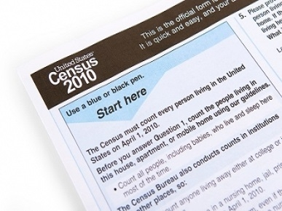
House of Representatives
The Lower House (House of Reps) was outlined in Article 1 Section 2
Only instance in the constitution where the Founding Fathers trusted ordinary men (white men with land) to elect government officials
Will of the People
Proportional Representation: Census
Census allocates the 435 members, every state gets at least 1 (Even Wyoming)
435 elected members and 6 non-voting members representing territories of the U.S.
Serve two-year terms (That’s to allow people to have more power)
Up for re-election every even year

Slide 13
How do we determine Members of the House?
Population of State
No State has fewer than 1 member
The state with the most representatives is California
435 members (fixed number) Proportioned after census

Slide 16
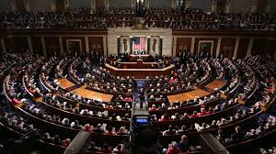
Powers Only Belonging to the House
Only the House can:
Initiate tax laws and spending bills
Initiate Impeachment of a President or other Government officials
In the event there is no majority for the Electoral College it is the House that casts the deciding vote

Slide 17
Qualifications of House Members
At least 25 years old
Lived in the U.S. for 7 years
Live in the State he/she will represent
Elected by the people

Slide 19
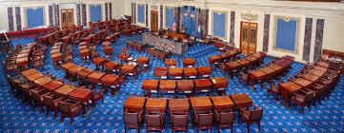
Senate
Article 1 Section 3 outlines the Upper house
The House of Representatives is intended to be the “Mad Dog” house passionate and ruled by the people
The Senate is to be protected and encased from the people: A little bit more of a tempered house
This allows the Senate to vote on issues that may not be in the best interest of the people, but of the nation
Equal Representation
2 Senators per State
6 year terms
1/3 Senate up for reelection

Slide 20
Powers Only Belonging to the Senate
Powers that only the Senate have:
Approve Presidential Appointments
Approve Treaties
Senate does Impeachment Trial ( Super Majority Needed 2/3)

Slide 22
Qualifications to be a Senator
At least 30 years old
Lived in the United States for 9 years
Live in the State he/she will represent
Senators serve six year terms
1/3 of the Senate are up for Re-election every even year
Before the 17th Amendment was ratified Senators were elected by State Legislatures not the people

Slide 23
Article 1 Section 7: Bills and Laws
House of Representatives are given the sole power to start revenue bills
Power of the Purse
Will of the People
A Bill can Start in either house
Once the Bill is passed by both houses it will move onto the Executive branch

Slide 24
Article 1 Section 8: Enumerated Powers
The enumerated powers are the powers that the congress is specifically allowed to do in the constitution
Examples are making money or setting up taxes

Slide 25
Article 1 Section 9 & 10: Limits to Congress

Slide 27
Rubric for Chart
You now will have 10 minutes I will be setting a timer to complete your T-Chart
This T-Chart is meant to be a quick reference guide for you
To receive an A on this you will need to fill out each box for both the House of Representatives and the Senate completely!

Slide 28
Your Turn!
It is now your turn to explain to me Article 1 of the constitution
Everyone will get into 10 groups
Each group will receive the one of the ten sections of the Constitution. Your job is to represent to me what that section is discussing
I will need at least 3 visual representations (drawings)
I will need at least 3 sentences in your own words explaining the meaning of the section
I will need at least 2 sentences explaining the importance of this section of the Constitution

