Slide 1
Bellwork- Lesson 8: Copy

Slide 2
Federalism Foldable
Follow the Flip-Flap Model I will be demonstrating in class
Label front four flaps: Federalism, Expressed and Implied Power, Concurrent Powers, Reserved Powers
Draw one Visual Representation on the front of the flap
Inside left flap put a definition
Inside right flap list the powers (For Federalism put an example)
On back of foldable answer question in one paragraph: Why are our Governmental Powers split between State and National Governments

Slide 3
House and Senate Leadership

Slide 4
Speaker of the House
The speaker is the principal leader of the House or Assembly.
The speaker typically will (1) preside over the daily sessions of the House or Assembly, (2) preserve order in the chamber, (3) state parliamentary motions, (4) rule on parliamentary questions, (5) appoint committee chairs and members, (6) refer bills to committee, (7) sign legislation, writs and warrants and (8) act as the official spokesman for the House or Assembly.

Slide 5
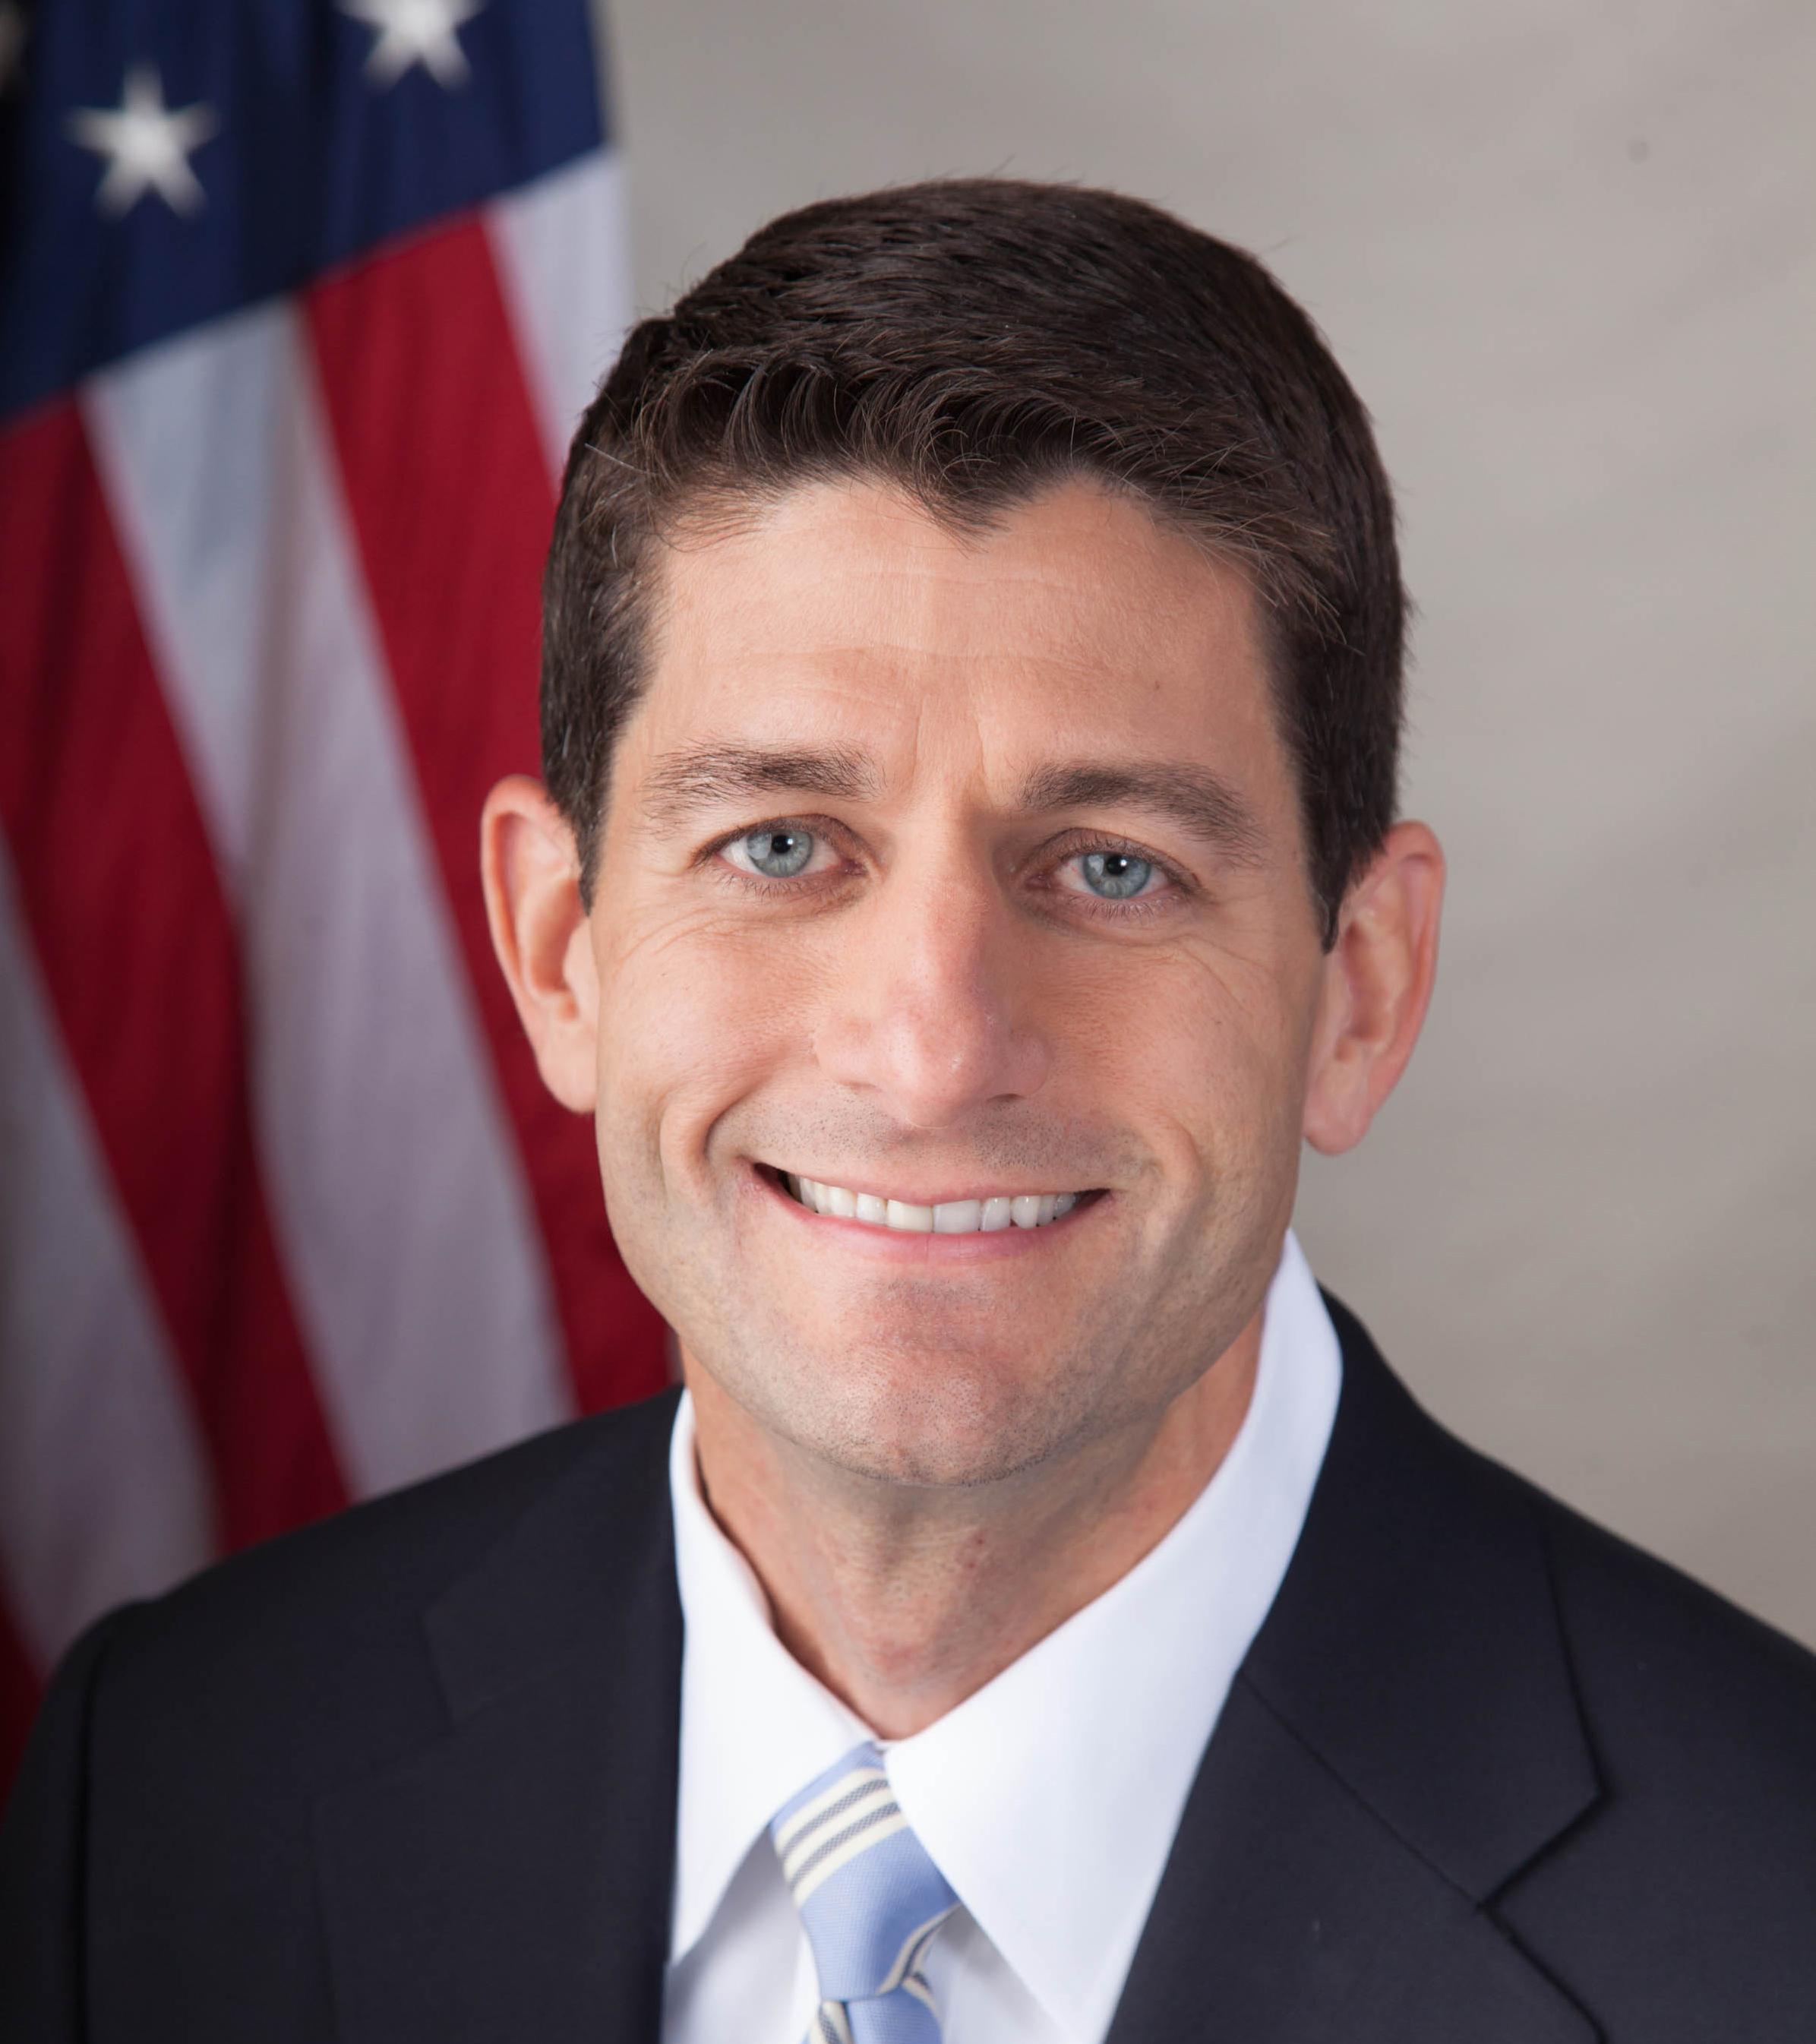
Speaker of the House
Paul Ryan
Republican
Wisconsin

Slide 6
President of the Senate
The vice president is the principal leader of the Senate.
The president typically will (1) preside over the daily sessions of the Senate, (2) preserve order in the chamber, (3) state parliamentary motions, (4) rule on parliamentary questions, (5) appoint committee chairs and members, (6) refer bills to committee, (7) sign legislation, writs and warrants and (8) act as the official spokesman for the Senate.
In about 26 states, the lieutenant governor serves as the president of the Senate, and many of these duties are assumed by the president pro tem.

Slide 7
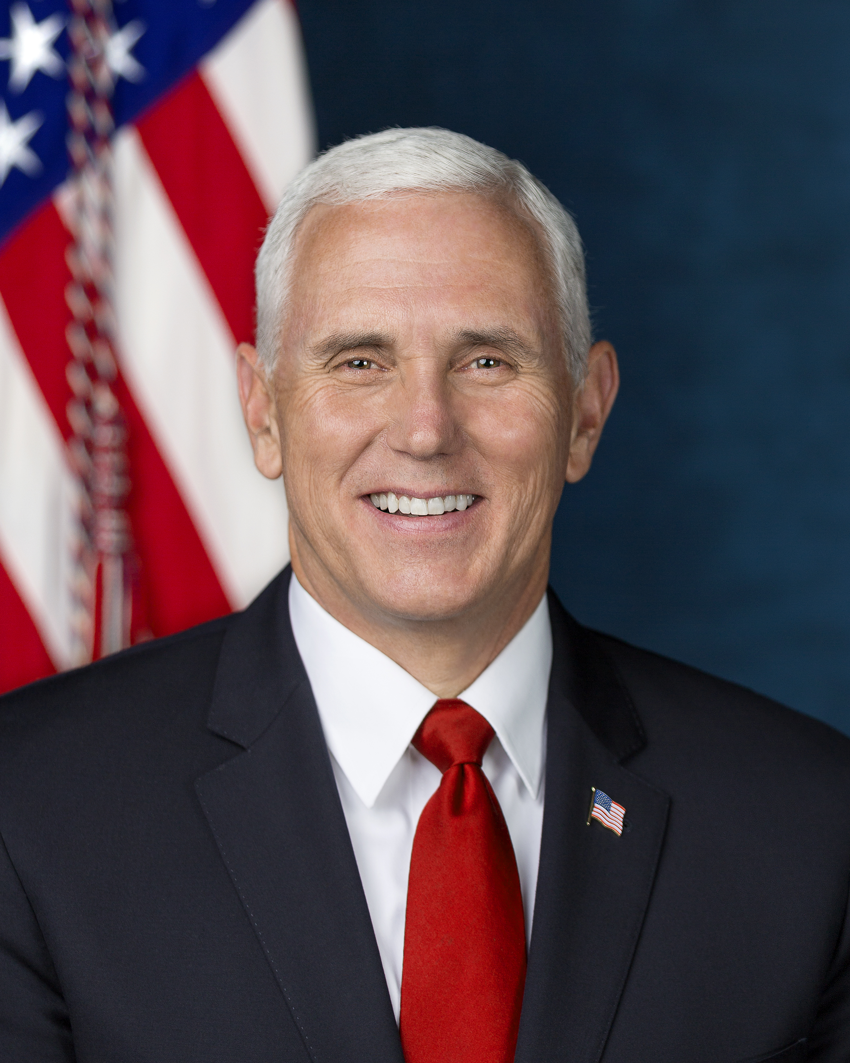
President of the Senate
Mike Pence
Republican
Indiana

Slide 8
President pro tem of the Senate
The primary roles assigned to the president pro tem are to (1) preside over the Senate in the president's absence, (2) exercise the powers and duties of the president in his or her absence and (3) assume other duties as assigned by the president.
Sometimes, this is an honorary position, with few substantive duties assigned.
In states where the lieutenant governor presides over the Senate, the president pro tem usually assumes duties associated with a president.

Slide 9
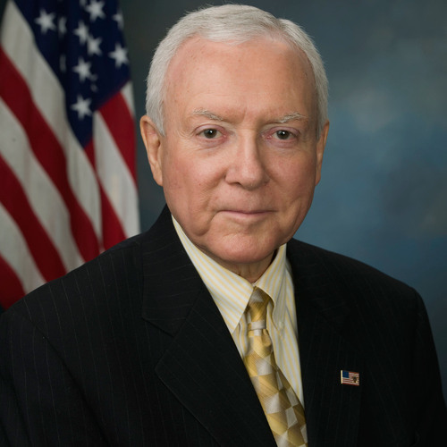
President pro tem of the Senate
Orrin Hatch
Republican
Utah

Slide 10
Majority Leader of the House and Senate
The primary functions of a majority leader usually relate to floor duties.
The majority leader (1) is the lead speaker for the majority party during floor debates, (2) develops the calendar and (3) assists the president or speaker with program development, policy formation and policy decisions.

Slide 11
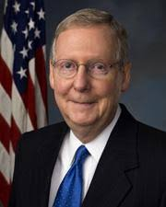
Majority Leader of the House and Senate
Mitch McConnell
Republican
Kentucky

Slide 12
Minority Leader of the House and Senate
The minority leader is the principal leader of the minority caucus.
The minority leader is responsible for (1) developing the minority position, (2) negotiating with the majority party, (3) directing minority caucus activities on the chamber floor and (4) leading debate for the minority.

Slide 13
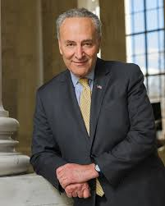
Minority Leader of the House and Senate
Charles E. Schumer
Democrat
New York

Slide 14
Majority Whip of the House and Senate
The duties of the majority whip are to (1) assist the floor leader, (2) ensure member attendance, (3) count votes and (4) generally communicate the majority position.

Slide 15
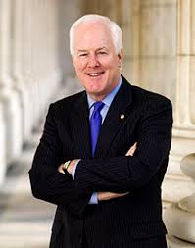
Majority Whip of the Senate
John Cornyn
Republican
Texas

Slide 16
Minority Whip of the House and Senate
The major responsibilities for the minority whip are to (1) assist the minority leader on the floor, (2) count votes and (3) ensure attendance of minority party members.

Slide 17
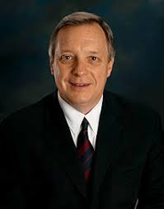
Minority Whip of the Senate
Richard Durbin
Democrat
Illinois

