Slide 1
Bellwork: Copy into your Composition Book
Primary Source: (also called original source or evidence) is an artifact, a document, diary, Manuscript, autobiography, article, a recording, letter, or any other source of information that was created at the time under study.
Importance of Primary Sources: These sources provide a window into the past. They are unfiltered access to the record of artistic, social, scientific, and political thought during the period under study.

Slide 2
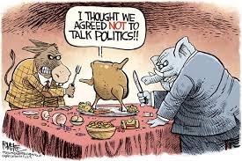
Political Cartoons

Slide 3
By the end of this lesson…
Students will be able to analyze the meaning and point of view of political cartoons
Students will understand the importance of political cartoons in a democracy

Slide 4
What is a viewpoint?
A point of view is a judgment or an idea that someone or a group or people hold on an issue.
Some issues have very divided viewpoints
Taxes
War
State vs. Federal government
Can you name any divided issues we have recently discussed in class?

Slide 5
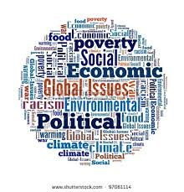
Poltical Cartoons
Commentary on current world events in the form of art
Political, economic, or social issues.
Makes use of humor, symbolism, historical events, and caricature.

Slide 6
The Rise of Political Cartoons
Modern American political cartoons have been around since the nineteenth century.
The increase in newspapers and magazine circulation in the 1800’s cultivated the environment for the rise and use of politcal cartoons
Famous cartoonists: Thomas Nast, A.J. Volck, and Joseph Keppler

Slide 7
Who’s the audience?
Political cartoons allow an artist to express the viewpoint to anyone, including those who can not read.
Communicated powerful ideas in a humorous and enlightened manner.

Slide 8
Political Cartoons- Five Characteristics
Symbolism
Exaggeration
Labeling
Analogy
Irony

Slide 9
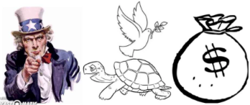
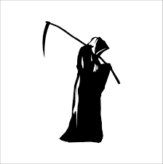
Symbolism
Cartoonists use simple objects, or symbols, to stand for larger concepts or ideas

Slide 10
Examples of Symbols
Peace: Dove, olive branch, victory sign
United States: Uncle Sam, flag, stars and stripes, shield
Democrats: Donkey
Republicans: Elephant
Death: Vulture, skeleton, skull and crossbones, grim reaper
Money: Dollar bill, money bags, dollar signs

Slide 11
Exaggeration
Sometimes cartoonists overdo, or exaggerate, the physical characteristics of people or things in order to make a point
Ears, Hat, Nose, Eyes, Hands, Objects etc.
Known as caricature

Slide 13
Labeling
Cartoonists often label objects or people to make it clear exactly what they stand for

Slide 15
Analogy
An analogy is a comparison between two unlike things.
By comparing a complex issue or situation with a more familiar one, cartoonists can help their readers see it in a different light.

Slide 16
Irony
Irony is the difference between the way things are and the way they are expected to be. things are and the way things should be

Slide 18
Point of View
Political Cartoonists express their opinion, or point of view, of a certain topic. It is important to keep in mind what the artist is trying to say with their cartoon
Knowing background information is important to understanding the cartoon
Use the 5 characteristics to understand the point of view!!

