Slide 1
Good Morning!
Please grab your composition book from the front of the room.
If you still have not turned in your composition book give it to Ms. Kenney
Begin working on the “Your Local Government” worksheet that you picked up

Slide 2
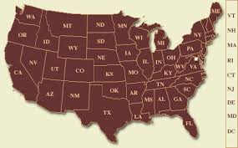
State & Local Governments
Roles, Responsibilities, and Powers

Slide 3
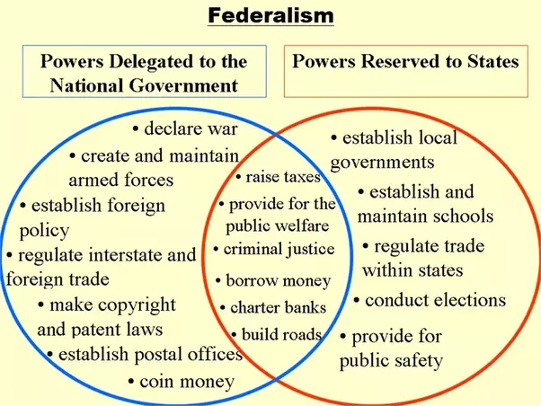
Federalism

Slide 4
Overview: State & Local Governments
Throughout American history we have focused on the importance of state and local governments
Federalism
Important function to our government
Local governments can be more responsive to citizens.

Slide 5
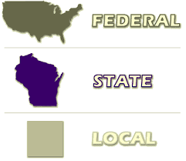
States Provide Services
It takes a lot to run a state
People need
Education
Transportation that works
Police and Courts
Water, electricity, someone to collect garbage
Emergency responders

Slide 6
States work with the federal government
States work with the Federal government
States pass laws and they carry out laws passed by the Federal government
States are closer to their citizens
This allows states to work directly with those involved with, or impacted by a law

Slide 7
States can respond to unique situations
States and Local governments can respond to unique situations
For Example: The Pennsylvanian Amish
allowed to set up their own schools that use private money
However, unlike most private schools, the Amish are allowed to have teachers without certificates and vastly different length of school year and curriculum

Slide 8
Governors
Every state has a leader called the governor
State Constitutions establish the powers and responsibilities of a governor
Governors mirror the responsibilities of a President
Run the state executive branch, influence state legislature, head of state and state political party, lead state’s National Guard, and serve as a liaison to the National government
Governors have the power to direct work of executive department and agencies, issue executive orders, direct state spending, and pardon people for state crimes.

Slide 9
Other executive leaders
Most states share power down to the local level (counties or cities)
This allows other executive leaders like a mayor, an appointed city manager, or an elected panel of commissioners

Slide 10
State Legislatures
Just like the United State’s House of Representatives and Senate
States allow citizens to elect representatives for their state government
This elected representative will vote on and pass state laws and legislation.

Slide 11
State Judicial System
As you can recall from the Judicial Branch… Florida has its own state Court System which includes
Florida Supreme Court
Florida District Court of Appeals
Florida Circuit Court
Florida County Court

Slide 12
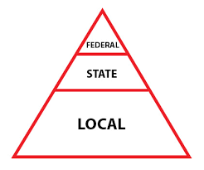
The Sunshine State- Our State Government
Florida was the 27th state in the United States
Admitted on March 3, 1845
The State Capital is Tallahassee
This is where our state conducts its governing actions
Florida is the 4th most populous state
After California, New York, and Texas
Florida’s major industries are tourism and agriculture

Slide 13
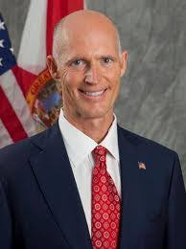
Your Governor
Rick Scott
Elected in 2010
Republican
Veteran later Businessman

Slide 14
Florida Legislative Branch
Florida’s Legislature is divided into two houses
House of Representatives
120 members
Senate
40 Senators

Slide 15
County Government- Polk County
Florida is divided into 67 counties.
People living in each county elect a board of commissioners to make the laws for their county and to run county government.
Counties have elected Jobs like the sheriff, tax collector, supervisor of elections, and county Judges.

Slide 16
Counties are responsible for land development and roads
County employees run courts, prisons, parks, libraries, and health care services.
The county court house contains offices for many of these county workers.
Each county in Florida has its own school district.
Which are responsible for coming up with county school policies

Slide 17
Municipal Government- City of Bartow
Within counties we have municipal governments
Usually ran by a mayor or city council
These deal with city issues
Work with city planning and city tourism
Parks and recreational activities
Sewer, Water, electricity (can be shared with county)
Develop police and fire departments

