Slide 1
Lesson 11: Bellwork
Copy: Today students will take a look at all of the outside factors that influence the Legislative Branch
This will include Gerrymandering, Political Parties, staff & colleagues, the President, Interest Groups & Lobbyists, Constituents, and the Role of the Media
Predict: In 1-2 sentences predict which of the above outside forces influences Politicians the most? Why?

Slide 2
Factors that Influence Congress
Members of Congress and the Laws that are Made

Slide 3
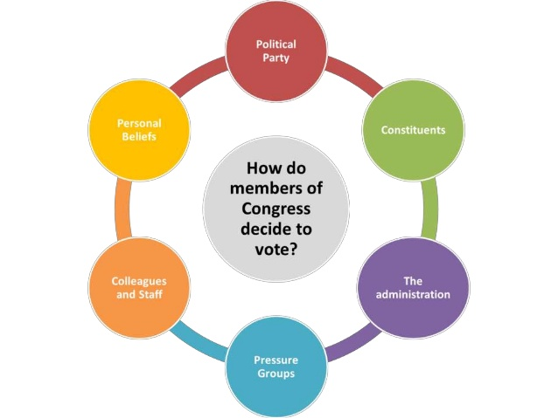

Slide 4
Who Influences Congress
The American people elect Senators and House members to represent the will of the people
How should elected representatives vote once sworn into office?
Should members of Congress reflect the will of the people, or should they pay attention to their own points of view, even if they disagree with their constituents?
Many factors influence the way a politician will vote

Slide 5
Political Parties
Each Party’s platform takes a stance on major issues
Loyal members often follow the “party line”
Congress is organized along party lines
Think about the Leadership. How is this organized?
Political parties determines
Leadership office
Committee assignments
Voting against your party will deeply hurt your chances for reelection
Members of Congress vote with their Political Party 80% of the time

Slide 6
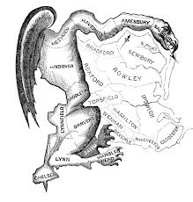
Gerrymandering
https://www.cbsnews.com/video/gerrymandering-a-threat-to-democracy/

Slide 7
Staff & Colleagues
More senior members influence newer members
Committee members who worked on legislation influence other members
Staff research issues and advise members
A member of congress looks to other members of his state to assess how an issue might affect his home state
Some people call this “trading votes”
However since no one person can know every single issue for the 10,000 bills being covered this is a practical way of making a decision

Slide 8
Interest Groups & Lobbyists
These groups often provide members with information on topics relating to their group’s interest
Testify at committee hearings and even conduct specific research that members request
Provide financial support in future campaigns
The larger the interest group the more power and voice you will have

Slide 9
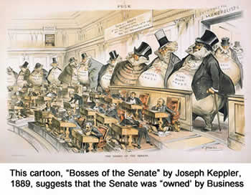

Slide 10
Constituents
Members of Congress tend to listen to their constituents:
town hall meetings keep members aware to prevent politicians appearing “out of touch”
It is crucial for hopes of reelection
Remember Congress members are representing their constituents and how they believe their constituents would vote on an issue

Slide 11
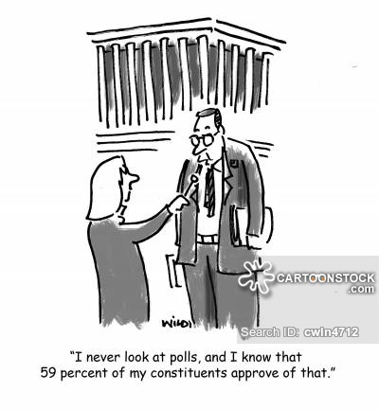

Slide 12
The Role of the Media in Politics
Journalism provides citizens with essential information about government institutions and helps shape public opinion.
Journalists help shape the agenda for public concern and debate.
Since the founding of the United States Journalists have served a watchdog role
In a way this is ow the citizens “check” the government.
Journalists keep a close eye on government officials to keep the public informed and to guard against corruption and the abuse of power
This is the relationship between the legislative branch and mass media

