Slide 1
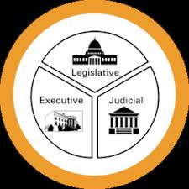
Why Government?

Slide 2
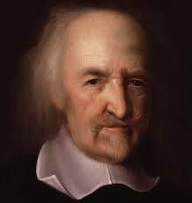
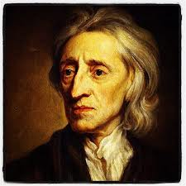
Why Government?
Thomas Hobbes
John Locke
Read page 1.
Why do you think Thomas Hobbes was right about human nature?
Do you agree with his outlook on the ‘right’ kind of government?
Read page 2.
Do you think Hobbes would agree with Locke’s idea of natural rights?
Do you prefer Hobbes’ or Locke’s ideas about government?

