Slide 1
You’ve Got Rights!

Slide 2
Amendment 1
Congress shall make no law respecting an establishment of religion, or prohibiting the free exercise thereof; or the freedom of speech, or of the press; or the right of the people peaceably to assemble, and to the government for a of
Protection #
reducing
ask
abridging
petition
redress
grievances.
fix
complaints
3, 15

Slide 3
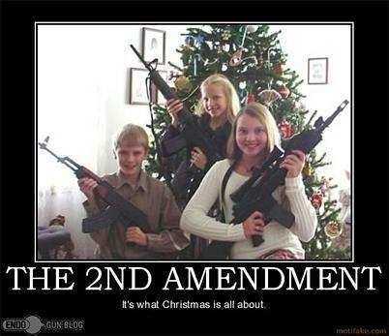
Amendment 2
A well regulated militia, being necessary to the security of a free , the right of the people to keep and bear arms, shall not be
Protection #
state
country
infringed.
violated
1

Slide 4
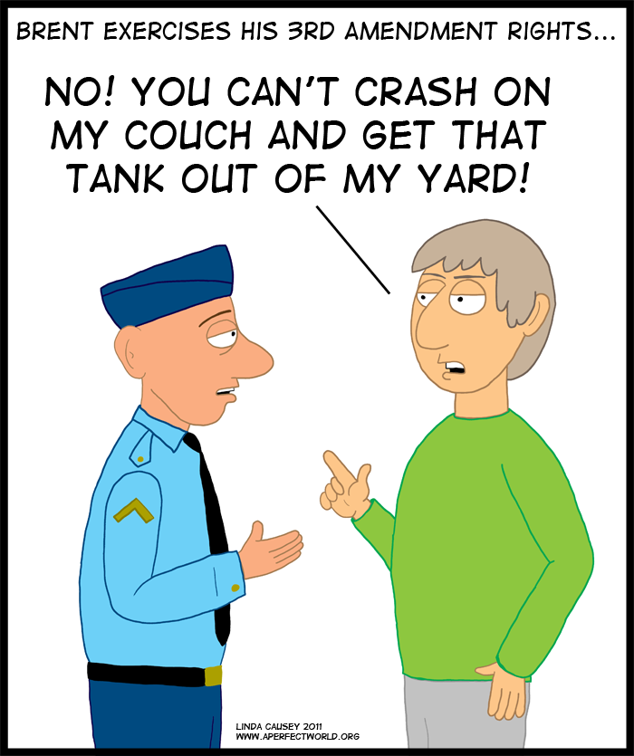
Amendment 3
No soldier shall, in time of peace be
in any house, without the consent of the owner…..
Protection #
quartered
housed
None

Slide 5
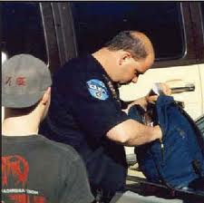
Amendment 4
things
The right of the people to be secure in their persons, houses, papers, and , against unreasonable searches and seizures, shall not be violated, and no warrants shall issue, but upon probable cause, supported by oath or affirmation, and particularly describing the place to be searched, and the persons or things to be seized.
Protection #
effects
11

Slide 6
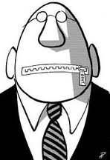
Amendment 5
crime
danger
No person shall….be subject for the same to be twice put in of life or limb; nor shall be in any criminal case to be witness against himself, nor be deprived of life, liberty, or property, without due process of law; nor shall private property be taken for public use, without compensation.
Protection #
offense
jeopardy
compelled
forced
just
fair
14

Slide 7
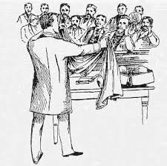
Amendment 6
trials
neutral
In all criminal , the accused shall enjoy the right to a speedy and public trail, by an
jury….and to be informed of the nature and cause of the accusation; to be confronted with the witnesses against him; to have process for obtaining witnesses in his favor, and to have the assistance of for his defense.
Protection #
prosecution
impartial
required
compulsory
counsel
lawyer
4

Slide 8
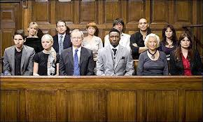
Amendment 7
In suits at common law, where the value in controversy shall exceed twenty dollars, the right of trial by jury shall be preserved, and no fact tried by a jury, shall be otherwise reexamined in any court of the United States, than according to the rules of the common law.
Protection #
none

Slide 9
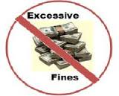
Amendment 8
Excessive bail shall not be required, nor excessive fines imposed, nor cruel and unusual punishments inflicted.
Protection #
5

Slide 10
Amendment 9
listing
The in the Constitution, of certain rights, shall not be to deny or disparage others retained by the people.
Protection #
enumeration
construed
interpreted
none

Slide 11
Amendment 10
given
delegated
The powers not to the United States by the Constitution, nor prohibited by it to the states, are reserved to the states respectively, or to the people.
Protection #
none

Slide 12
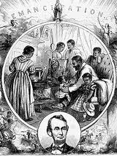
Amendment 13
Neither slavery nor involuntary servitude, except as a punishment for crime whereof the party shall have been duly convicted, shall exist within the United States, or any place subject to their jurisdiction.
Protection #
10

Slide 13
Amendment 14
given citizenship
All persons born or in the United States . . . are citizens of the United States and of the state wherein they reside. No state shall make or enforce any law which shall abridge the or of citizens of the United States; nor shall any state deprive any person of life, liberty, or property, without due process of law; nor deny to any person within its jurisdiction the equal protection of the laws.
naturalized
things you don’t have to do
rights
privileges
immunities
Protection # 9

Slide 14
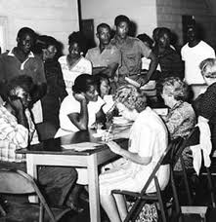
Amendment 15
The right of citizens of the United States to vote shall not be denied or abridged by the United States or by any state on account of race, color, or previous condition of servitude.
Protection #
7

Slide 15
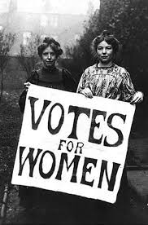
Amendment 19
The right of citizens of the United States to vote shall not be denied or abridged by the United States or by any state on account of sex.
Protection #
7

Slide 17
Amendment 26
The right of citizens of the United States, who are 18 years of age or older, to vote, shall not be denied or abridged by the United States or any state on account of age.
Protection #
7

Slide 18
Pamphlet Protections
Now with your partner highlight the protections that are in the Bill of Rights then choose one missing right and think of a reason why it’s missing. Be ready with an answer to share with the class.

Slide 19
You’ve Got Rights! Activity
With your partner, read each statement and choose which amendment that is the best match.

Slide 20
You’ve Got Rights! Activity
1
You have the freedom of religion, speech, press; and the right to assemble peacefully and petition the government.
2
Citizens can keep and bear arms.
3
You don’t have to house soldiers in your home during peacetime.

Slide 21
You’ve Got Rights! Activity
4
No unreasonable searches and seizures.
5
The government cannot deprive you of life, liberty or property without due process of law.
6
The right to have a jury hear your case in a criminal trial.

Slide 22
You’ve Got Rights! Activity
7
The right to have a jury hear your case in most civil trials.
8
Bail, fines and punishment must not be excessive.
9
Did you find a right not listen in the constitution? It still belongs to the people!

Slide 23
You’ve Got Rights! Activity
10
If a power isn’t given to the federal government, it goes to the states or the people.

